Slide 1
MKB(Mother Knows Best)
A “World-Record” Competitor for Artificially Intelligent Tetris Play

Slide 2
What is MKB?
2-piece Tetris playing program
Components:
Genetic Algorithm
Artificial Neural Network

Slide 3
Outline
Genetic Algorithm
What is it?
How did I use it?
Artificial Neural Network
What is it?
How did I use it?
Synergistic Integration
How do they work together?
Results

Slide 4
What is Tetris?

Slide 5
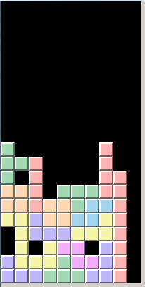
What’s important?
Total blanks:
3

Slide 6
What’s important?
Total holes:
New holes:
3
1

Slide 7
What’s important?
Total holes:
New holes:
Lines cleared:
3
1
0

Slide 8
What’s important?
Total holes:
New holes:
Lines cleared:
Width/height:
Height (from top):
3
1
0
2/3
11+2*12+13
1
2
3
4
5
6
7
8
9
10

Slide 9
What’s important?
Total holes:
New holes:
Lines cleared:
Width/height:
Height (from top):
Piece touch(side):
3
1
0
2/3
11+2*12+13
1

Slide 10
What’s important?
Total holes:
New holes:
Lines cleared:
Width/height:
Height (from top):
Piece touch(side):
Wall touch:
Solid under:
3
1
0
2/3
11+2*12+13
1
3
1

Slide 11
What’s important?
=W1 * Total holes +
W2 * New holes +
W3 * Lines cleared +
W4 * Width/height +
W5 * Height +
W6 * Piece touch +
W7 * Wall touch +
W8 * Solid under

Slide 12


Genetic Algorithm

Slide 13
Genetic Algorithm

Slide 14
Genetic Algorithm
“Living” = number of pieces placed
Attributes:
Height
Cleverness
Strength
Etc.
Set of weights:
{W1, W2, W3, W4, W5, W6, W7, W8}

Slide 15

4.2 million pieces

Slide 16
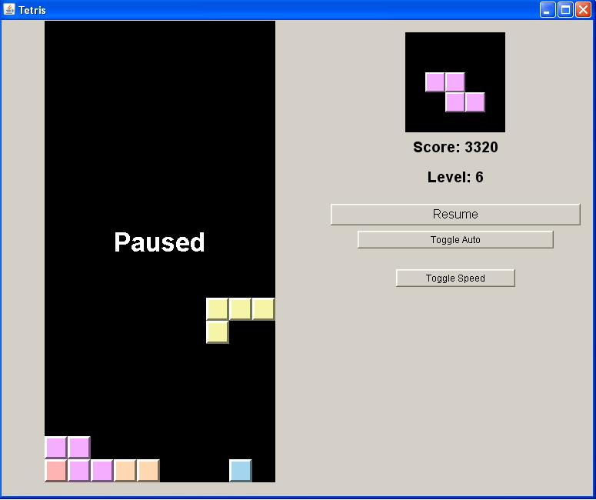

Slide 17
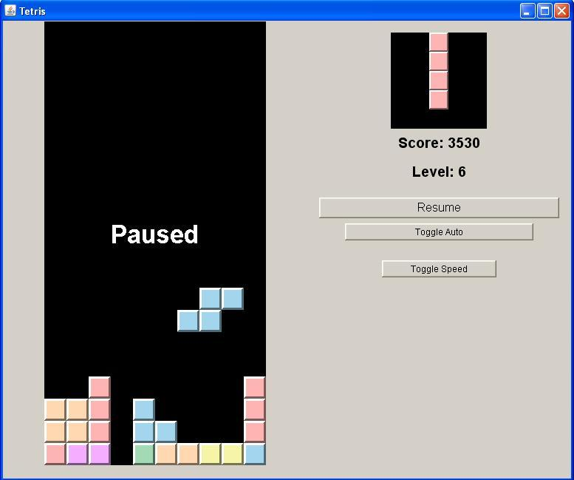

Slide 18
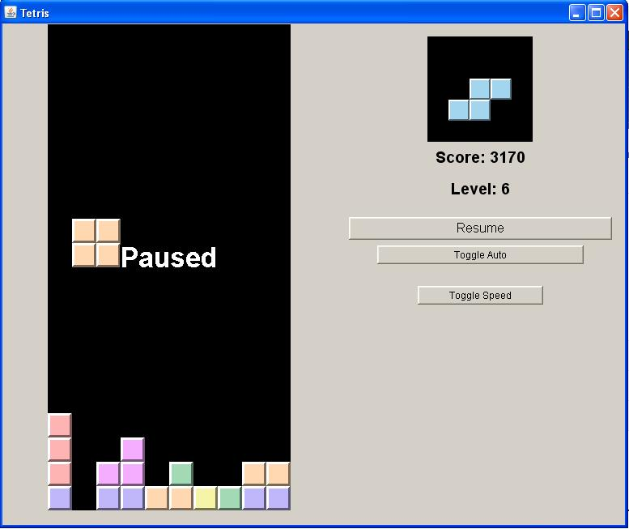

Slide 19
~9.3%

Slide 20
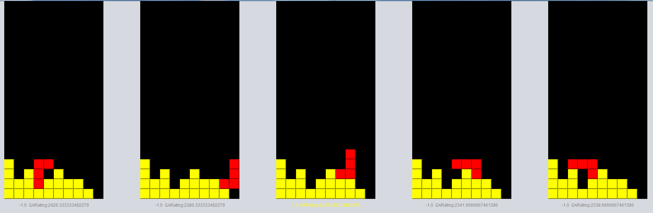
Synergistic Integration
GA
1
2
3
4
5
Should choice 1 be doubted?
No: Do it.
Yes:

Slide 21

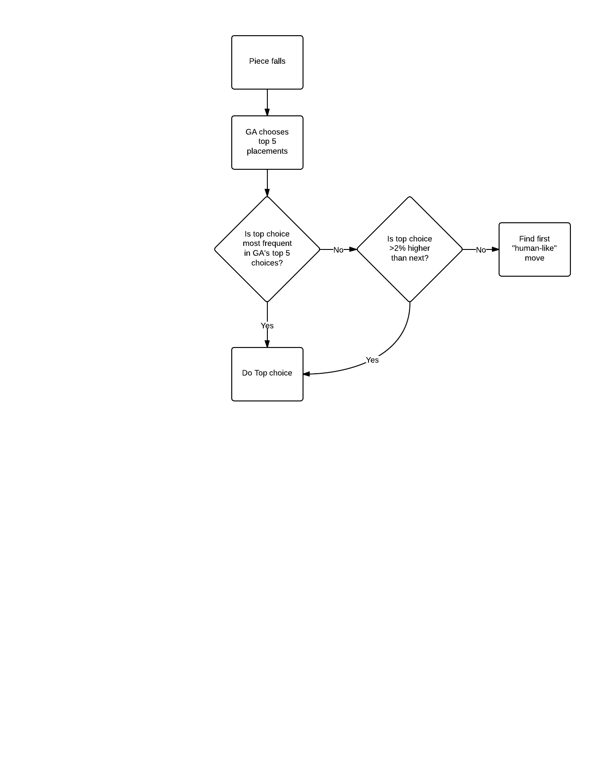

Slide 22
Results

Slide 23
Results

Slide 24
Results

